Slide 1

Computer Programming

Slide 2
What is Computer Programming?
Computer programming is the process of designing and building an executable computer program to accomplish a specific computing result or to perform a specific task
The purpose of programming is to find a sequence of instructions that will automate the performance of a task
The source code of a program is written in one or more languages that are intelligible to programmers (called high level programming languages)
The computer will take that source code and convert it to a language that it understand (called machine language)
Because it's very hard for humans to write code in machine language we developed the high level programming languages and the process to convert them into machine language

Slide 3
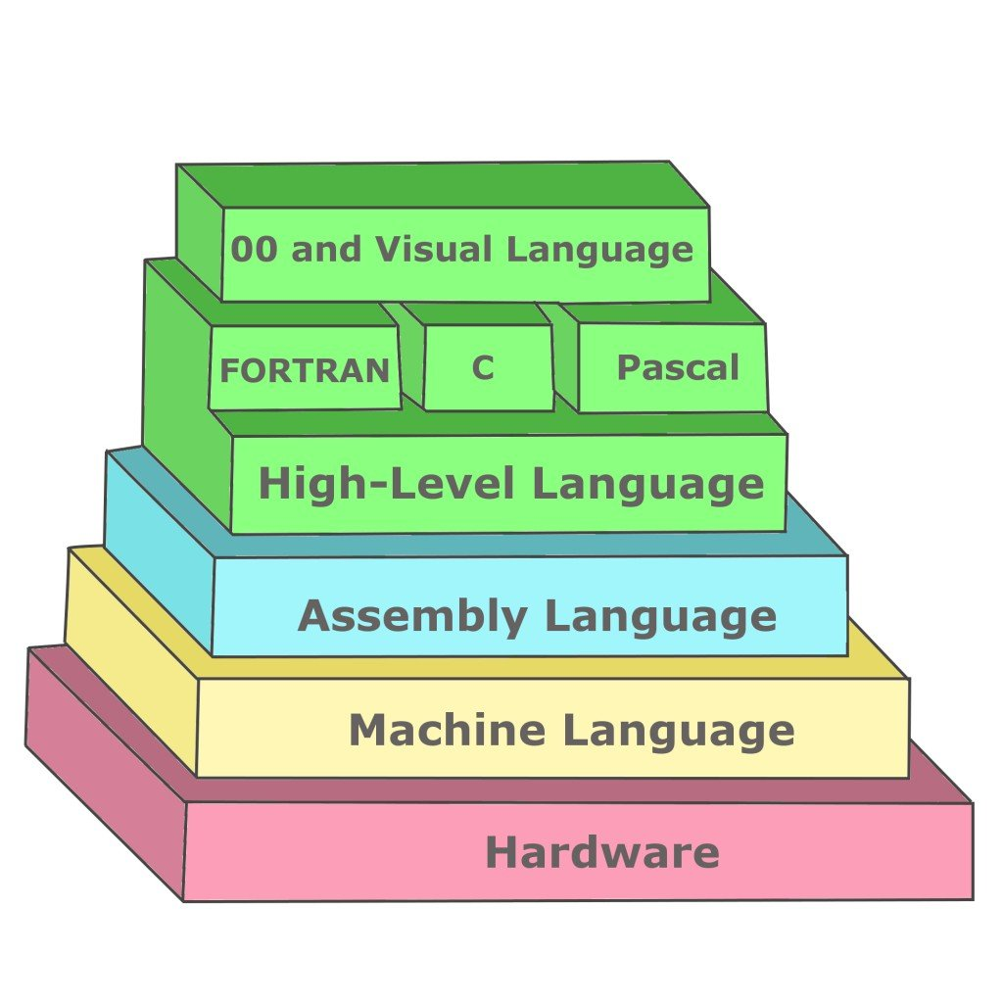

What is Computer Programming?

Slide 4
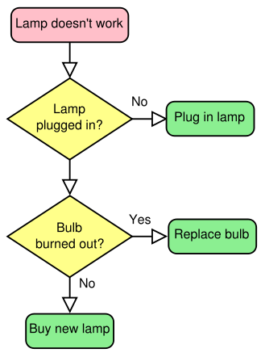
What is Algorithm?
In computer science an algorithm is a set of steps for a computer program to accomplish a task
algorithms are not just in the computer science context, We are using algorithms every day to perform every task in our lives For example - fixing lamp algorithm:

Slide 5
What is a Good Algorithm?
We can create a lot of different algorithms to accomplish the same task
A good algorithm is an algorithm that should:
Successfully perform the task it meant to perform
Be efficient - accomplish the task with the least steps posible and use minimal resources
Be easily to understand - maintainable algorithm that reflects easily the creator thinking process
Be flexible - know how to handle all kinds of exceptions and errors
Be balanced - balance between efficient and readable

Slide 6
What is a Flowchart?
A flowchart is a type of diagram that represents a workflow or process
The flowchart shows the steps as boxes of various kinds, and their order by connecting the boxes with arrows
This diagrammatic representation illustrates a solution model to a given problem
Flowcharts are used in designing and documenting simple processes or programs

Slide 7
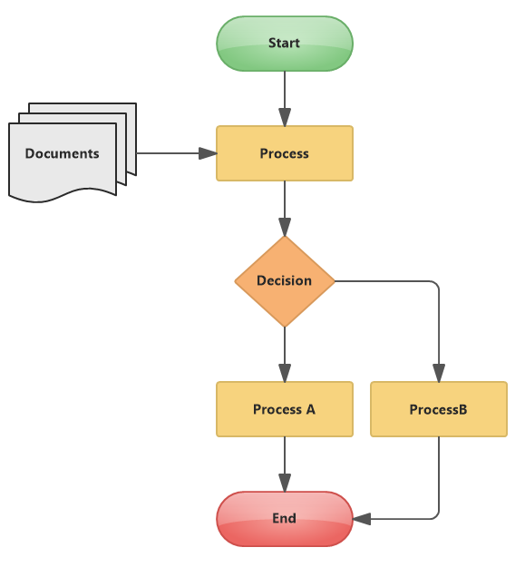
Examples for Flowcharts
Fixing a lamp flowchart Flowchart template

Slide 8
Flowchart Symbols
Start / End Symbol Determine the start and end points of the flowchart (usually with the world “Start” or “End” inside it
Action Symbol The action can represent a single step like (“add sugar”) or much complex process like (“make coffee”)
Decision Symbol The decision represent different choices that in order to complete the process we should choose from Every choice can lead to different actions in the diagram

Slide 9
Flowchart Symbols
Input / Output Symbol Represent information that the program will show during the process (for example print a response)

Slide 10

Making Coffee Process Flowchart

Slide 11
What is a Programming Flowchart?
A programming flowchart is a flowchart that show the data flow of a programing algorithm
By using programming flowcharts we can easily describe the logic and the steps behind our algorithm
Also, by using programming flowcharts we can easily test our algorithm efficiency and find edge cases and errors we should handle

Slide 12
Programming Flowchart
Let’s try to create a simple programming flowchart:
Our simple algorithm should get 3 integers as an input and find the largest integer
How can we do it?
Note: We don’t know what the integers are going to be except the fact that they are integers

Slide 13
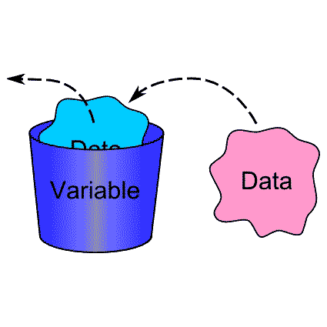
Variables

Slide 14
What are Variables?
Variables are used to store information that we will want to use and save in our computer program, They are a very important concept in computer science
You can think of variables as containers that hold data that you assigned to it
Variables provide a way of labeling data with a descriptive name, so us and others could more easily understand our program
Variables sole purpose is to label and store data in memory, This data can then be used throughout your program

Slide 15
How Variables will solve our Flowchart problem?
By using a variables we could store our input numbers and use them wherever we need
in our flowchart
For example:
We could store every integer we got as an input as a letter and use the letter as
reference to the integers we got -
variable “a” will be first integer input
variable “b” will be second integer input
variable “c” will be third integer input
Now every time we will right “a”, “b” or “c” this will be a reference to our inputs so our program will replace this variable name with the value it stored

Slide 16
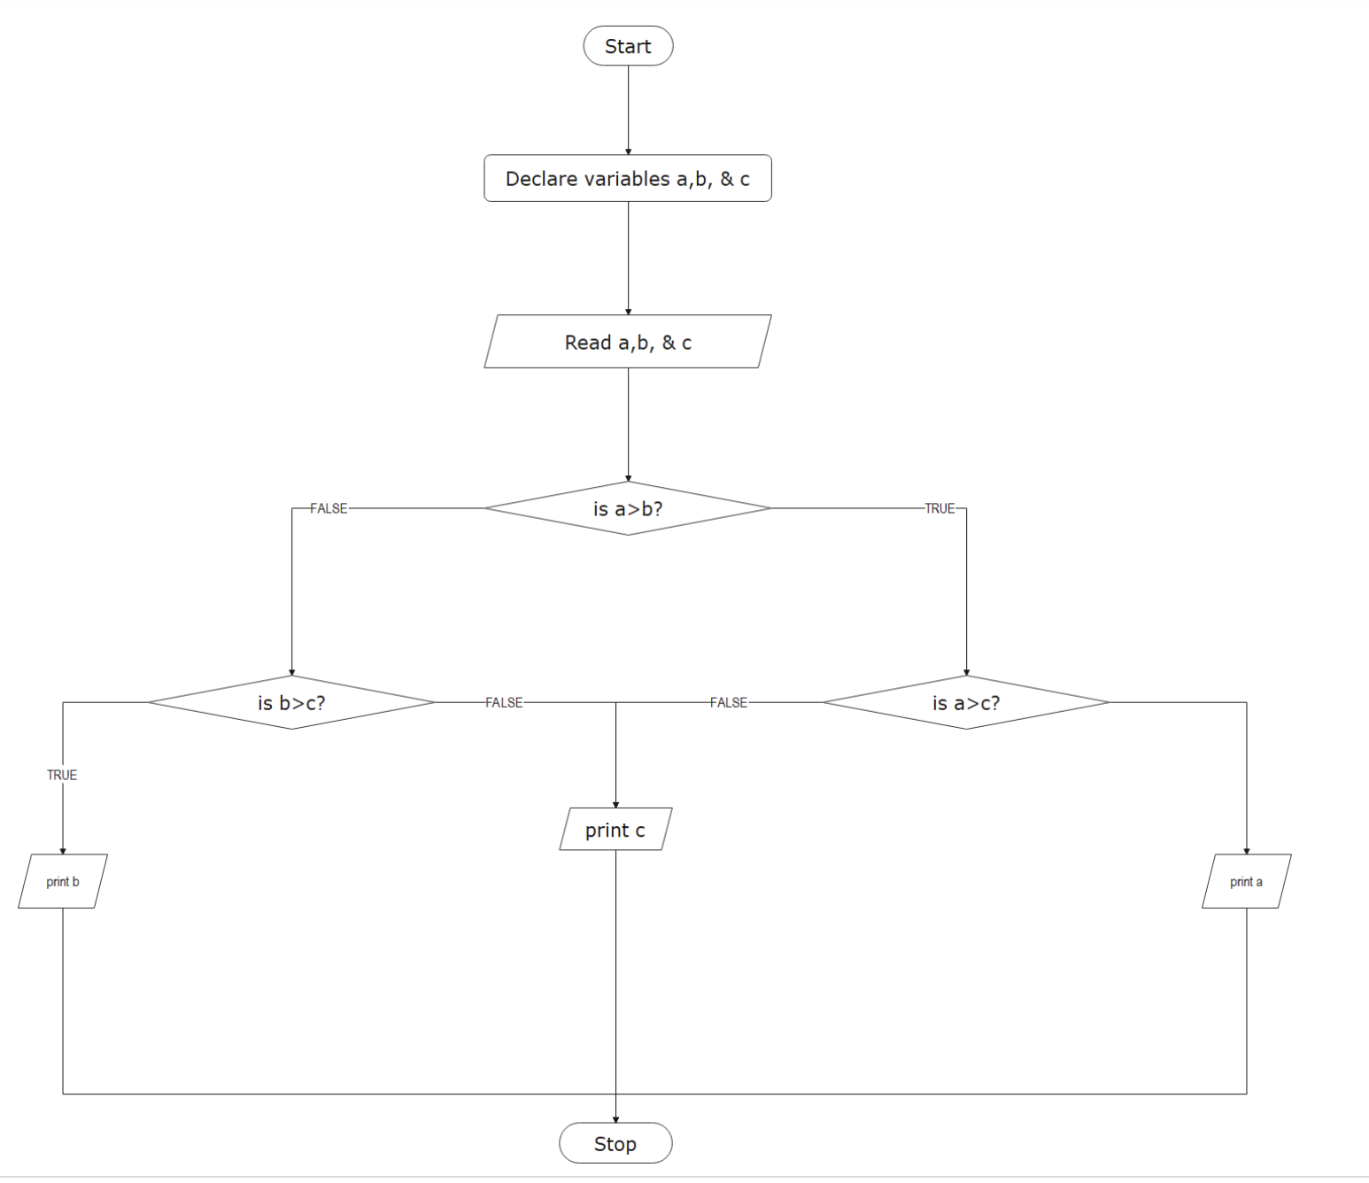
Our Flowchart should look like this:

Slide 17
Primitives Variables Types
Primitive variables are variables that have a fixed size in memory
We should choose what primitive variable to use by knowing the type of the data that we want to store and the size of it
The larger the size of our variable to more space it will take in our memory This is why it is important to use the right variable for the right purpose
Unlike more complex variables (we will learn about them later in the course), primitive variables doesn’t have any additional methods

Slide 18
Primitives Variables Types
We have 7 different types of primitive variables:
byte - size: 1 byte (-128 to 127)
short - size: 2 bytes (-32,768 to 32,767)
int - size: 4 bytes (-2,147,483,648 to 2,147,483,647)
long - size: 8 bytes (-9,223,372,036,854,775,808 to 9,223,372,036,854,775,807)
float - size: 4 bytes Stores fractional numbers, can store 6 to 7 decimal digits
double - size: 8 bytes Stores fractional numbers, can store 15 decimal digits
boolean - size: 1 bit Stores true or false values
char - size: 2 bytes Stores a single character/letter or ASCII values

Slide 19
Class Exercise - Programming Flowchart

Slide 20

Class Exercise - Programming Flowchart
Instructions:
Write programming flowcharts, as we learned in this leacure, that show the algorithm for performing those tasks:
An algorithm that takes 3 whole numbers and a “isSum” variable If the “isSum” variable is true -> your program should return the sum of all the numbers If the “isSum” variable is false -> your program should return the largest number from all 3 numbers given
An algorithm that takes a minute number and convert it to second For example - if you got the number 2 you should return 2*60 = 120 seconds
Use primitive variables in your flowchart to save the arguments, think what variable type will be better to use for saving each argument
Think about all the edge cases that your program can have and reflect them in your flowchart

Slide 21
Class Exercise - Programming Flowchart Solution

